Slide 1
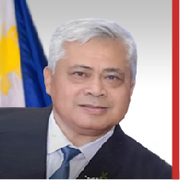
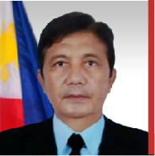
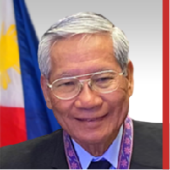
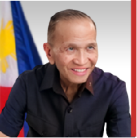
GIL C. MENESES
Corporate Secretary
• BS PMA 1980, Magna Cum Laude, Grad #2
• PhD, Peace and Security Administration
• Masters, Public Safety Administration, Silver Medal
• Bachelor of Laws (LLB), Cum Laude
• Director, Civil Security Group (CSG), PNP
• Technical Consultant, PMS, OP, 2017-2022
• Member, Rotary Club of Loyola Heights, QC
• Member, Philippine BAR, 1994
ROLANDO M. AQUINO
Treasurer & Chairman, Finance Committee
• BS PMA 1983
• Master in Defense Studies, University of Canberra, Australia
Wing Commander, 205THW & 410th MW
• Independent Trustee, AFPMBAI, 2015-2016
• Member, BOD Air Cavalier Credit Coop, 2015-2021
• Presidential Lingkod Bayan Award, CSC, 2014
The Outstanding Phil Soldier 2006
Cavalier Award Air Force Operations, 1994
RUFINO G. IBAY JR.
Awards Committee
• BS PMA 1967 with Academic Board Star
• Masters Degree in Economics, UP School of Economics
• Director for Comptrollership, PNP
• President & CEO, AFPSLAI, 2003-2006
• Acting Chairperson, John Hay Management Corporation
• Member, Rotary Club of Pasay MIA
• MA in Economics , PhD on Peace and Security, Bicol University
MANUEL B. MARIANO
Chairman, Bylaws Amendment Committee
• BS PMA 1962
• Masters in Management, AIM
• Masters in Business Economics (UA and P)
• Commander, AFP LOGCOM
• Chairman and CEO, Videogram Regulatory Board
• Member, BOT, TG PMA HOP Foundation
• Distinguished Conduct Star
• Presidential Lingkod Bayan Award
• President, Rotary Club of Greenmeadows
• First AFP Senior Officer Graduate of
the National Defense University
at Washington DC, USA

